Slide 1

Computational Framework for Understanding Microbial Pathogenesis and Antimicrobial Resistance (AMR)
Molecular biology and basic cellular physiology (24AIM112 )
Ethics, innovative research, businesses & IPR (24AIM115 )
RAGUL U. - CB.AI.U4AIM24036
RAMKUMAR R. - CB.AI.U4AIM24033
SHWETHA P. - CB.AI.U4AIM24042
PRAGALYA M. - CB.AI.U4AIM24032

Slide 2
Introduction
Antimicrobial Resistance (AMR):
AMR is when microbes resist drugs, making infections harder to treat.
Understanding the genetic mechanisms behind host-pathogen interactions and AMR is crucial for developing effective prevention and treatment strategies.
Our project focuses on analyzing gene sequences to uncover insights that can aid in combating infections.
2

Slide 3
Objective
Predict Antimicrobial Resistance (AMR)
Study Host-Pathogen Interactions
Apply Machine Learning for Predictions
Provide a Scalable and Cost-Effective Approach
3

Slide 4
Literature review
1.Prediction of antimicrobial resistance based on whole-genome sequencing and machine learning
Demonstrated SVM,CNN models can effectively predict AMR with label encoding, one-hot encoding and frequency matrix chaos game representation (FCGR encoding) on whole-genome sequencing data,identify mutations that are associated with AMR for each antibiotic.
2.Machine learning-enabled prediction of antimicrobial resistance in foodborne pathogens
Application of ML combined with WGS and spectroscopy techniques to identify and predict AMR in foodborne pathogens which is crucial to assure food safety
3.Ethics and antibiotic resistance
the ethical challenges posed by antibiotic resistance, emphasizing the severe and unevenly distributed health consequences. It critiques common frameworks like patient responsibility, the tragedy of the commons, and antibiotic stewardship, highlighting their limitations
4

Slide 5
Literature review
4.Towards routine employment of computational tools for antimicrobial resistance determination via high-throughput sequencinge
It highlights advancements in bioinformatics pipelines, database improvements, and automation to enhance AMR prediction. The study emphasizes the need for standardization and routine implementation to improve clinical and public health responses.
5.Balancing the risks and benefits of antibiotic use in a globalized world: the ethics of antimicrobial resistance
Addressing AMR's ethical dimensions includes fair resource allocation, environmental impact, and conflicts of interest in antibiotic development. Equitable access to antibiotics and stakeholder collaboration in stewardship are crucial to ensure public interest and responsible use. Balancing risks and benefits demands innovative, global strategies to preserve antibiotic efficacy for future generations.
5

Slide 6
Computational aspects to be used
Data Retrieval & Preprocessing
UniProt, CARD, VFDB (Virulence Factor Database), STRING, KEGG
Sequence Alignment & Similarity Search
BLASTp, Clustal Omega
Host-Pathogen Interaction Prediction
STRING, ClusPro, KEGG pathway mapping
Molecular Docking & Structural Analysis
SwissDock, PyMOL for protein-ligand interaction
Python (Biopython, Pandas, Scikit-learn)
6

Slide 7
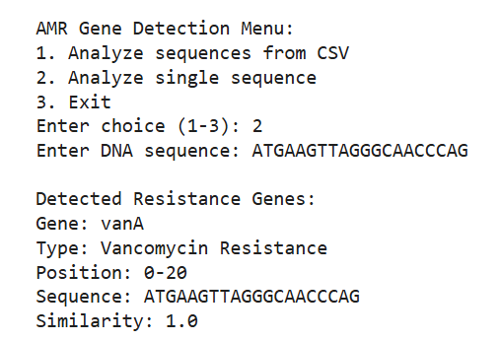
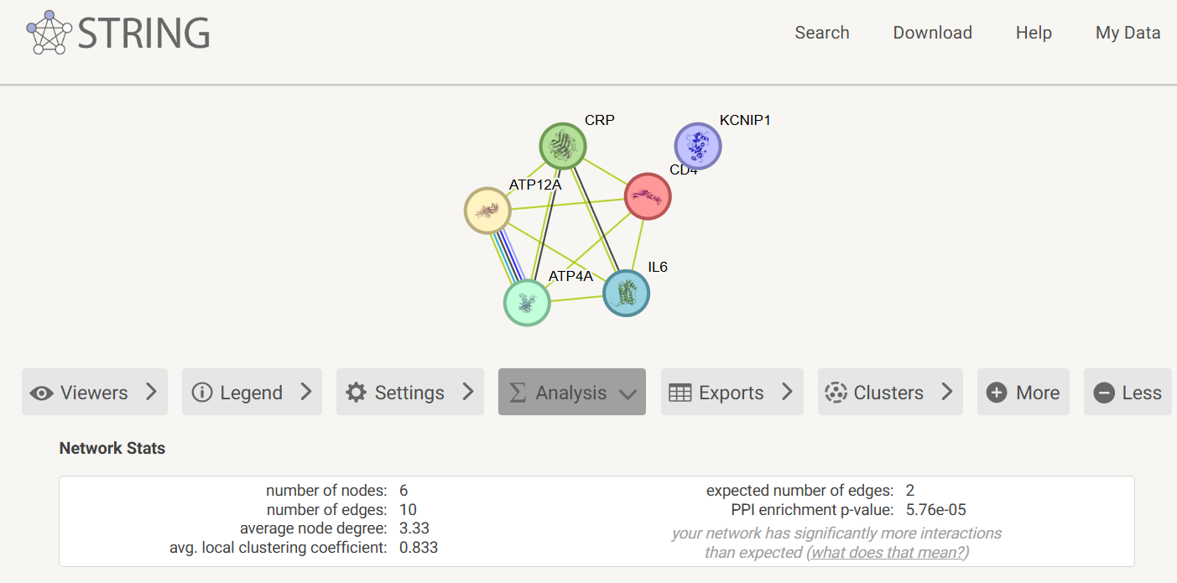
Fig. Output obtained from the draft Model trained for AMR Prediction
Fig. Output obtained from STRING: functional protein association networks
7

Slide 8
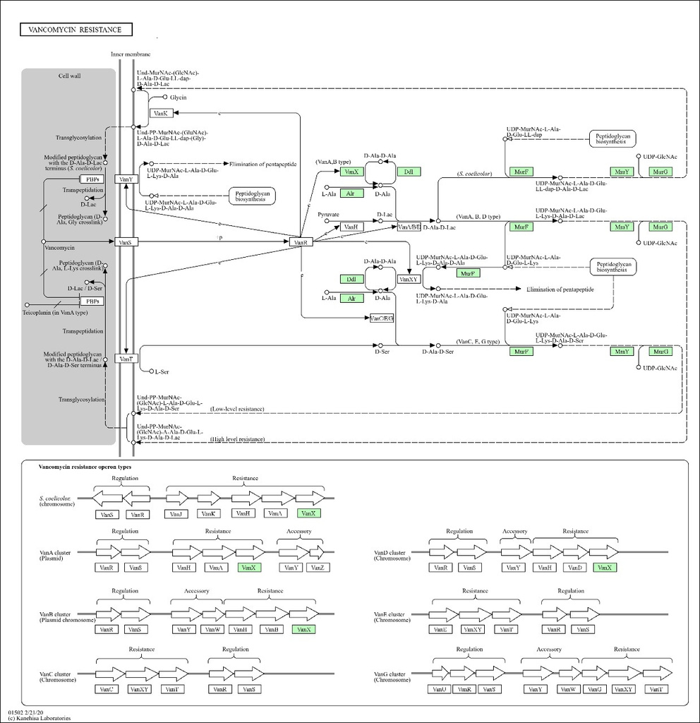
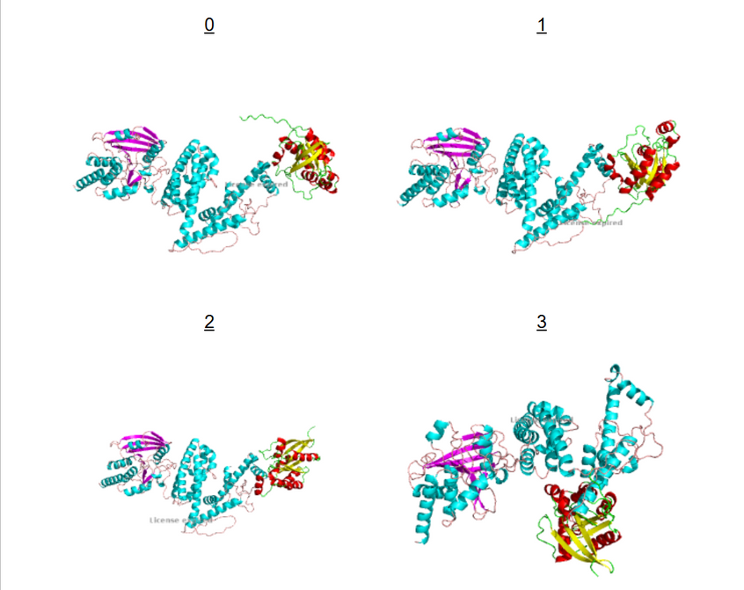
Fig. Output from ClusPro for interaction between host-pathogen
Fig. Output from KEGG for protein interaction between host-pathogen
8

Slide 9
Tools used
NCBI GenBank & RefSeq
https://www.ncbi.nlm.nih.gov/datasets/
AlphaFold Protein Structure Database
https://alphafold.ebi.ac.uk
CARD (Comprehensive Antibiotic Resistance Database)
https://card.mcmaster.ca/analyze/rgi
UniProt Virulence Factors (Virulence Genes/Proteins)
https://www.uniprot.org/uniprotkb
KEGG Pathways (bacterial genes interacting with host proteins)
https://www.genome.jp/kegg/pathway.html
9

Slide 10
Ethical Challenges
1.Responsibility & Overuse
Healthcare Providers – Overprescription due to patient pressure and uncertainty.
Patients – Self-medication and incomplete antibiotic courses.
2. Public Health vs. Individual Health
Doctor’s Dilemma – Balancing immediate patient needs vs. preventing long-term resistance.
Moral Responsibility – Ethical use of antibiotics to avoid future health crises.
3. Global Inequality
Rich Countries: Overuse of antibiotics accelerates resistance.
Poor & Unregulated Markets: Limited access, substandard or counterfeit drugs
worsen AMR.
10

Slide 11
Intellectual Property Rights (IPR) Issues
1. Profit vs. Public Health
Pharmaceutical companies prioritize profits over developing truly innovative antibiotics.
Many focus on narrow-spectrum drugs (easier to patent), worsening AMR.
2. Influence on Prescription Practices
Aggressive marketing of antibiotics increases overuse.
Pharma companies fund biased research and promotions, influencing doctors' prescribing habits.
3. Research & Development (R&D) Incentives
Companies hesitate to invest in new antibiotics due to low profitability.
Governments should offer grants, tax credits, and funding for innovation.
4. Regulation & Global Collaboration
Stricter patent policies needed to prevent excessive commercialization.
Fair licensing and data-sharing agreements for global access to new antibiotics.
11

Slide 12
Proposed Solutions for IPR Issues
Proposals suggest offering $1 billion rewards for new antibiotics that meet urgent needs.
Multiple global partnerships have been formed to develop new antibiotics and to promote responsible use.
Governments and organizations have proposed global funds to support antibiotic Research & Development.
Priority review vouchers allow companies developing new antibiotics to fast-track approval for other drugs or sell the voucher to others.
Incentives and new policies are formed to encourage research in the field of Antibiotic Resistance in many countries.
12

Slide 13
Ideas Patented
Computational Modeling and Simulating of Host-Pathogen Interactions (US20050055188A1)
Computational model to predict host pathogen interactions would ease concerns regarding animal testing. In addition, it would be desirable to have such a model to Save hours of research time and costs
Glycomimetics to Inhibit Pathogen-Host Interactions (US9605014B2)
This patent includes computer-aided methods for generating glycomimetics designed to inhibit pathogen-host interactions, highlighting the application of computational tools in therapeutic development.
13

Slide 14
References
[1] Yunxiao Ren, Trinad Chakraborty, Swapnil Doijad, Linda Falgenhauer, Jane Falgenhauer, Alexander Goesmann, Anne-Christin Hauschild, Oliver Schwengers, Dominik Heider, Prediction of antimicrobial resistance based on whole-genome sequencing and machine learning, Bioinformatics, Volume 38, Issue 2, January 2022, Pages 325–334, https://doi.org/10.1093/bioinformatics/btab681
[2] Mingxin Hou, Xiaowen Zhong, Ouyang Zheng, Qinxiu Sun, Shucheng Liu & Mingxin Liu. (2025) Innovations in seafood freshness quality: Non-destructive detection of freshness in Litopenaeus vannamei using the YOLO-shrimp model. Food Chemistry 463, pages 141192.
[3] Hazrat Bilal, Muhammad Nadeem Khan, Sabir Khan, Muhammad Shafiq, Wenjie Fang, Rahat Ullah Khan, Mujeeb Ur Rahman, Xiaohui Li, Qiao-Li Lv, Bin Xu,The role of artificial intelligence and machine learning in predicting and combating antimicrobial resistance,Computational and Structural Biotechnology Journal,Volume 27,2025,Pages 423-439,ISSN 20010370,https://doi.org/10.1016/j.csbj.2025.01.006.
[4] Kari Pahlman, Anson Fehross, Greg J Fox, Diego S Silva - Ethical health security in the age of antimicrobial resistance: BMJ Global Health 2022;7:e007407.https://doi.org/10.1136/bmjgh-2021-007407
[5] Adebisi, Y.A. Balancing the risks and benefits of antibiotic use in a globalized world: the ethics of antimicrobial resistance. Global Health 19, 27 (2023). https://doi.org/10.1186/s12992-023-00930-z
14

